Slide 1

SharePoint Embedded
A New Way to Build a New Kind of App
SharePointEmbedded＠microsoft.com

Slide 2
Welcome & Congratulations SharePoint Embedded City Tour, June 2025 London✅, Stockholm✅, Helsinki✅, Madrid ✅, Chicago, Atlanta, Houston, New York

Slide 3



Your Team Today
Reid Carlberg
in/reidcarlberg
James Eccles
in/ecclesjames
Clalissa Yi
in/clalissayi

Slide 4




Four Big Ideas
AI is the fastest growing technology ever.
Your apps will all be AI apps.
Documents are the secret sauce for AI apps.
Integrated AI is your fastest path to value.

Slide 5
Documents introduce unique challenges
Understanding unstructured data
Collaboration
Security
Compliance
Data Residency
Versioning
Sharing
Search

Slide 6

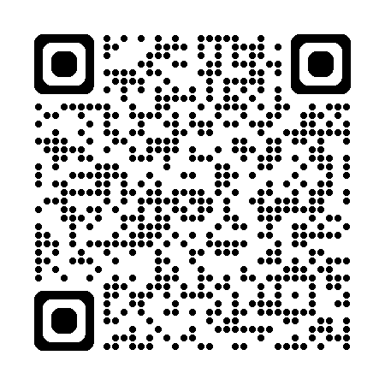
SharePoint Embedded
API-only version of SharePoint for AI apps that use documents.
Delivers M365 Copilot, Office Collaboration,
Purview Compliance for every app, as an Azure service.
https://aka.ms/start-spe

Slide 7
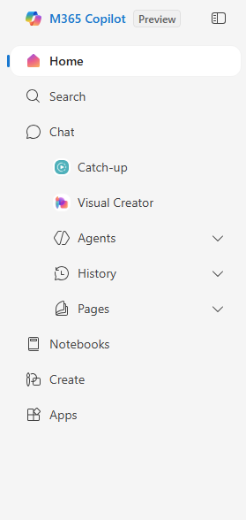
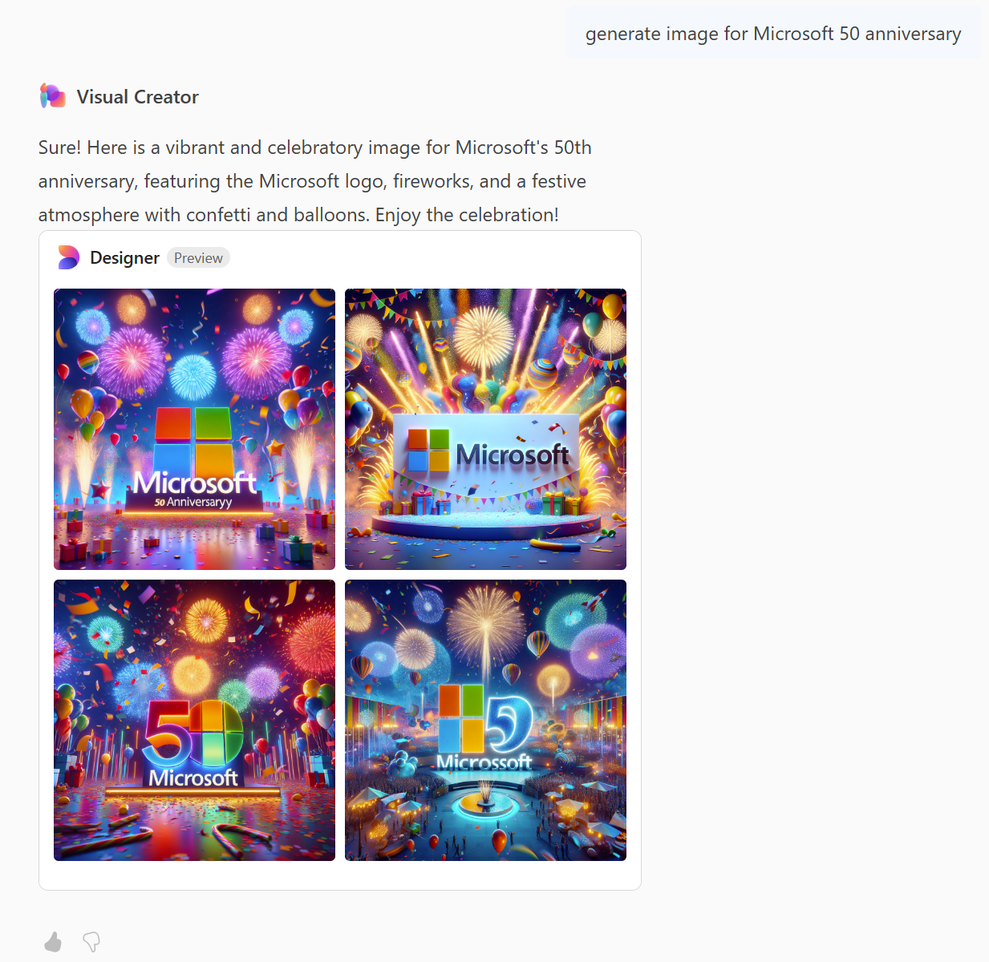
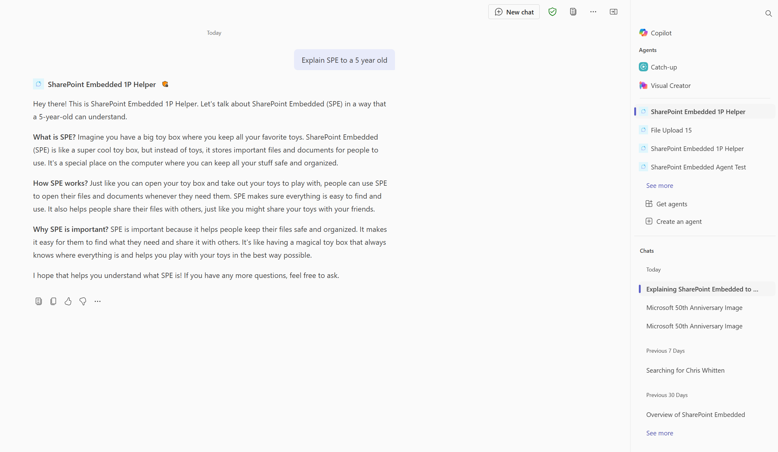
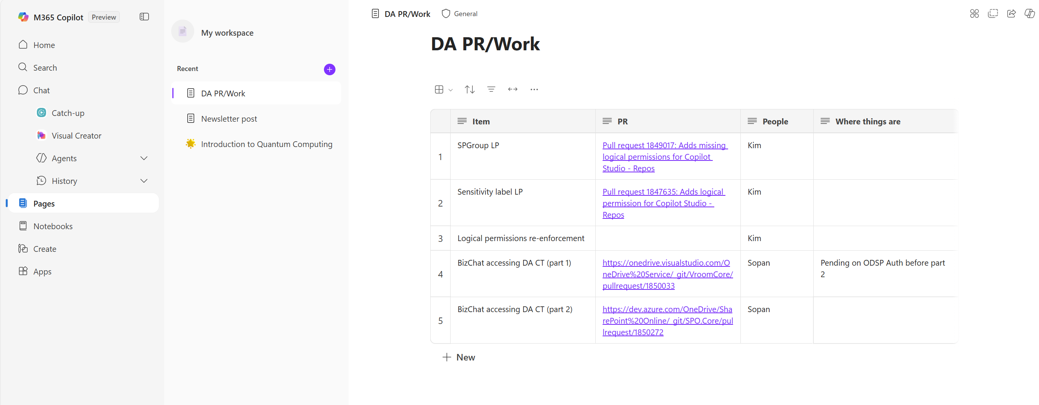
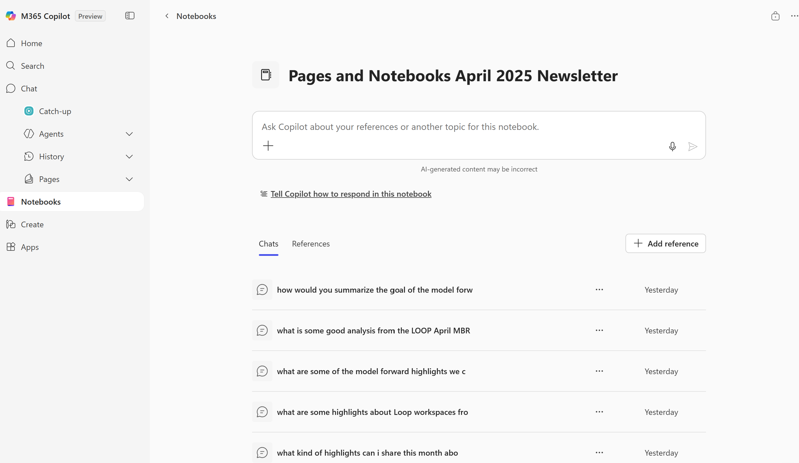
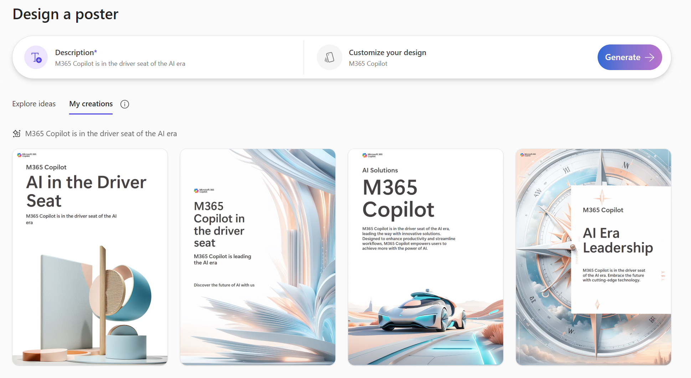
SharePoint Embedded Powers Microsoft 365 Copilot
Visual Creator
Declarative Agents w/ Embedded Knowledge
1
2
1
Copilot Pages
3
2
Copilot Notebooks
4
3
4
5
Create (Designer)
5

Slide 8
Integrated AI Platform for Document Apps
Security
AI Native
SharePoint Embedded
Full AI stack for enterprise apps and agents
Commitments
Capabilities
Collab

Slide 9
Agenda
9:00 – Kickoff and Foundations (you are here)
10:00 – Break
10:20 – Getting Started
11:20 – Break
11:30 – Compliance and Admin
12:15 – Lunch & Learn
12:30 – App Chat & Roadmap
13:00 – Done
Questions? We’re hanging around until 14:00

Slide 10
Demo #1: SharePoint Embedded in Action

Slide 11
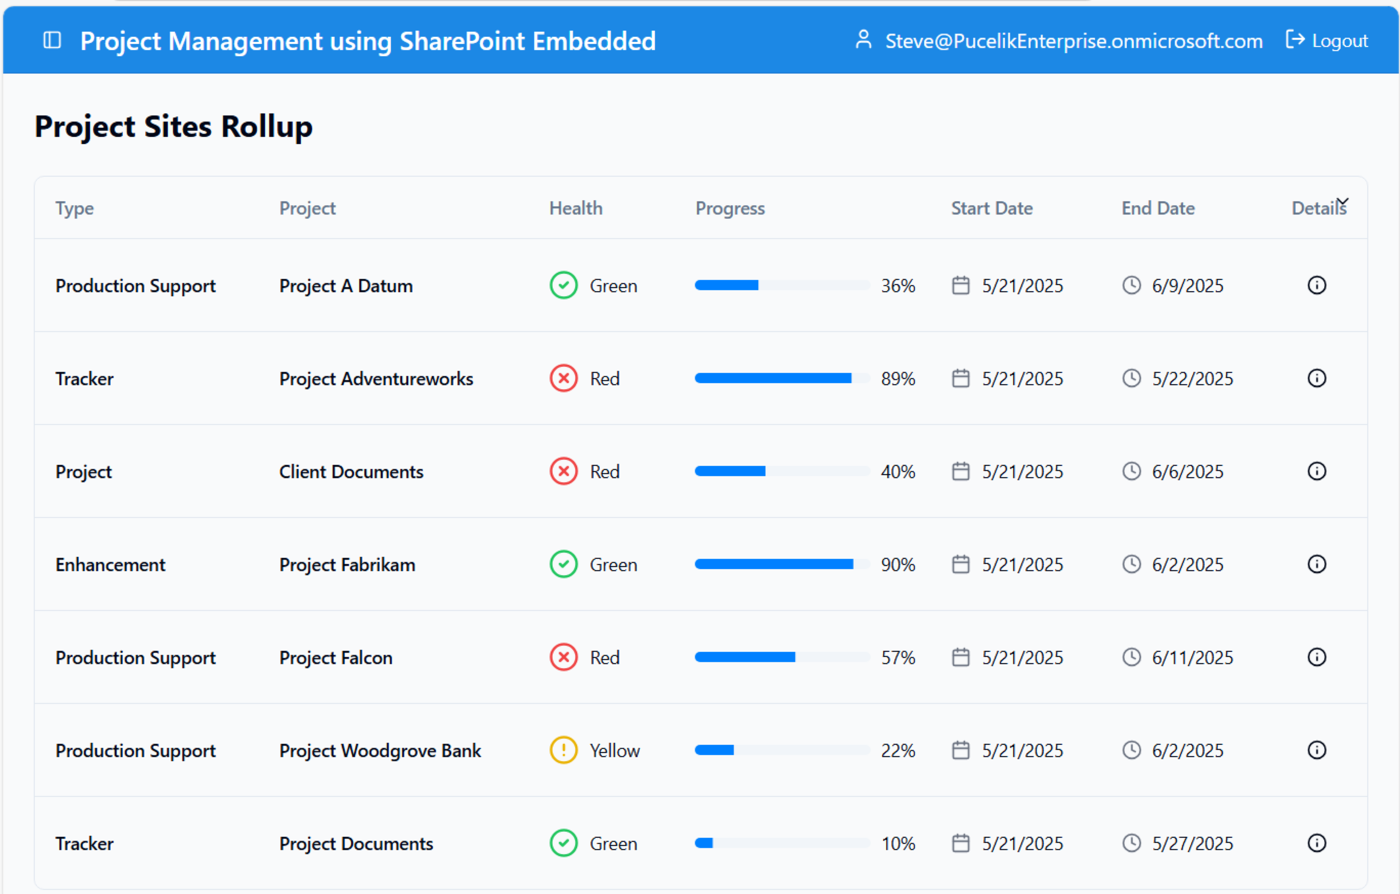
What did we see?
Entra integration
1-click collaboration, Word, Excel, PowerPoint
Preview, works with more than 300 files types
Search integration
Custom copilot agent
Permissions and sharing
Admin Integration

Slide 12
Microsoft 365 Features via Your App
Copilot
Compliance
Collaboration
Core Storage
Documents added to SharePoint Embedded are natively ready for Copilot using components you add to your app
Comprehensive set of solutions designed to help organizations govern, protect, and manage data across their entire data estate
A one-click native collaboration, preview, and sharing experience for docs stored as part of any app. No configuration needed
Dedicated storage partitions within your Microsoft 365 tenant, providing secure and isolated containers for documents
M365 Copilot
Semantic Index
Semantic Search
Custom Interface
OCR
eDiscovery
Auditing
Data loss prevention (DLP)
Bring your own key (BYOK)
GDPR / CCPA / etc.
Retention policies
Sensitivity labels
Conditional access
Word, Excel, and PowerPoint
Full desktop support
Co-authoring/live presence
@ Mentions
Sharing to internal & external users
Preview for popular file types like PDFs
Microsoft 365 Archive
Any file type
Integrated search
Metadata
250 GB files
Automatic versioning
Redundant storage
File & folder perms
Recycle Bin

Slide 13


SPE Manages Data in an Isolated Partition
Microsoft 365 Tenant Boundary
M365 App APIs
Graph APIs
SharePoint Online
OneDrive
SharePoint Embedded
Microsoft 365 Storage Platform

Slide 14
SPE Manages Data in an Isolated Partition
External App
Internal App
Microsoft 365 Tenant Boundary
M365 App APIs
Graph APIs
My Amazing App Containers
Your Amazing App
Containers
Your Amazing App
Your Amazing App
SharePoint Online
OneDrive
SharePoint Embedded
Microsoft 365 Storage Platform

Slide 15
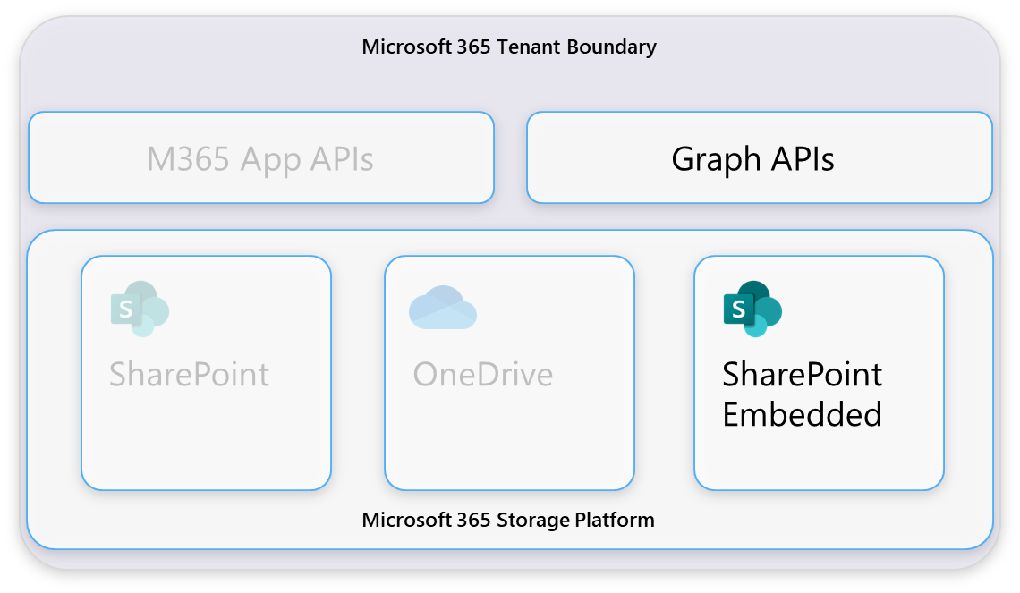
SharePoint Embedded Containers
SharePoint Embedded Containers
New file & document mgmt primitive
Lightweight – fast instantiation
Highly scalable – 100k per app
App has full control over its containers
Containers map to your business construct
Scale unit and security boundary
Management in SharePoint Admin w/ RBAC

Slide 16
How It Works
User gestures…
External App calls…
Microsoft Graph API connects…
SharePoint Embedded provides webUrl…
…opens Word / Excel / PowerPoint

Slide 17
API Demo

Slide 18
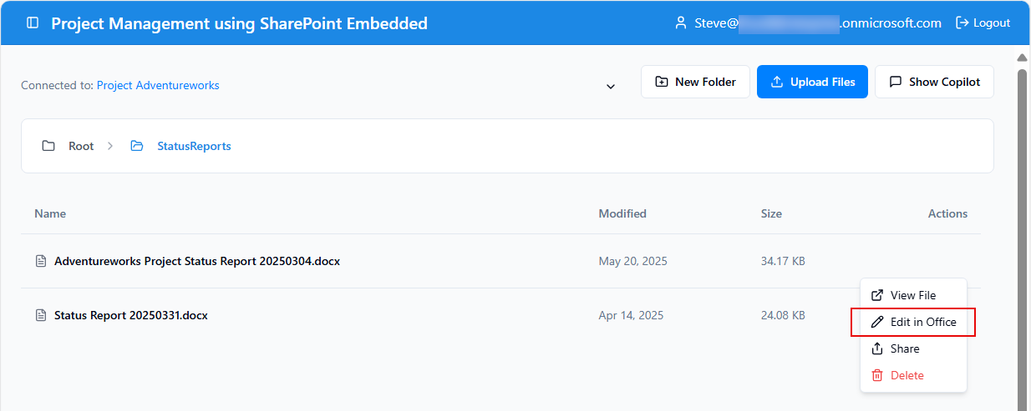

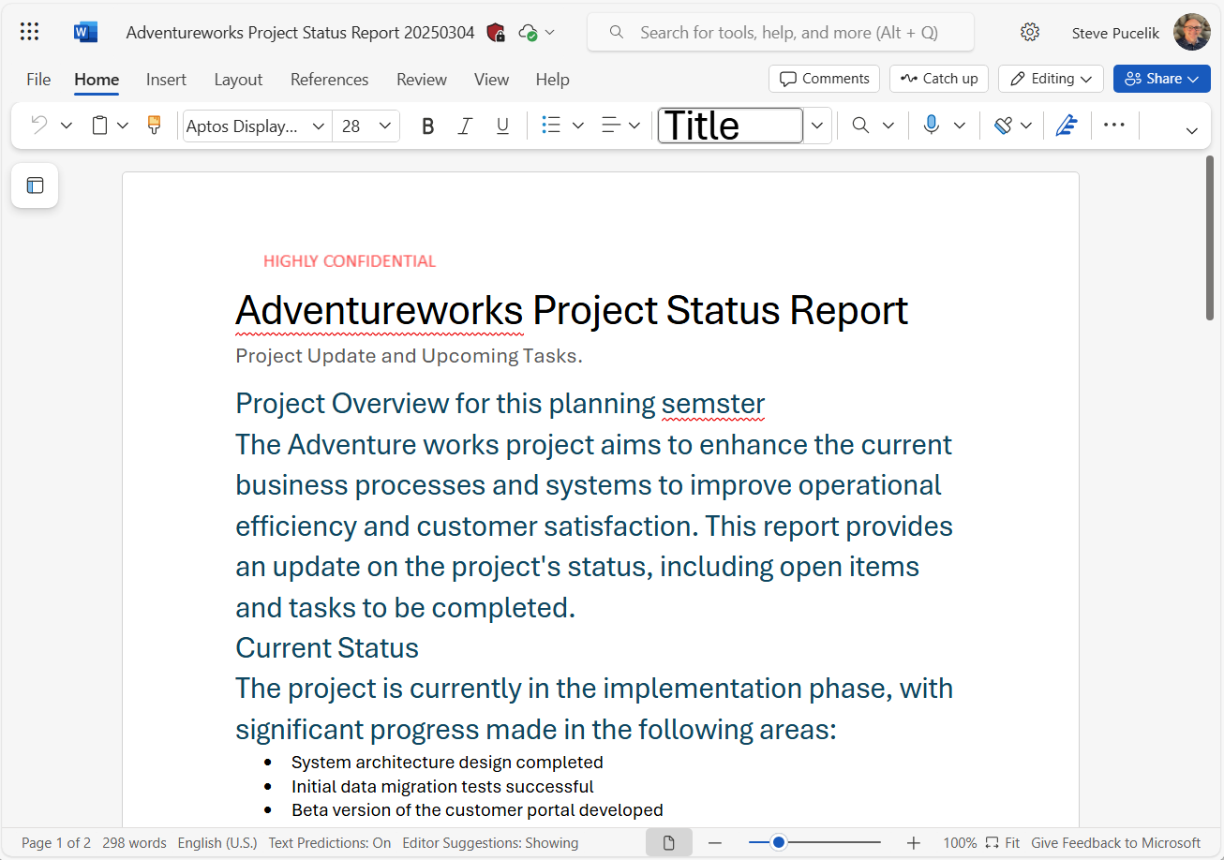

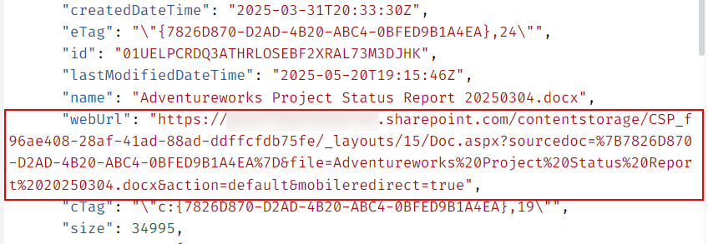
One Click Collaboration
Familiar User Experience
Full Office Web & Desktop Support
Co-authoring & Collaboration
App Branding in Office
M365 Discovery – Office.com, Recommended
Embeddable File & Document Previewer
Configurable Sharing
The File API response has everything you need – no configuration required

Slide 19
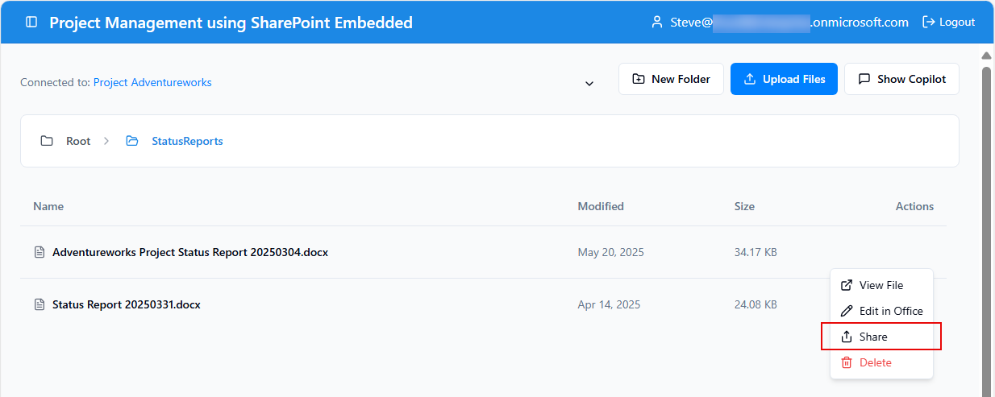
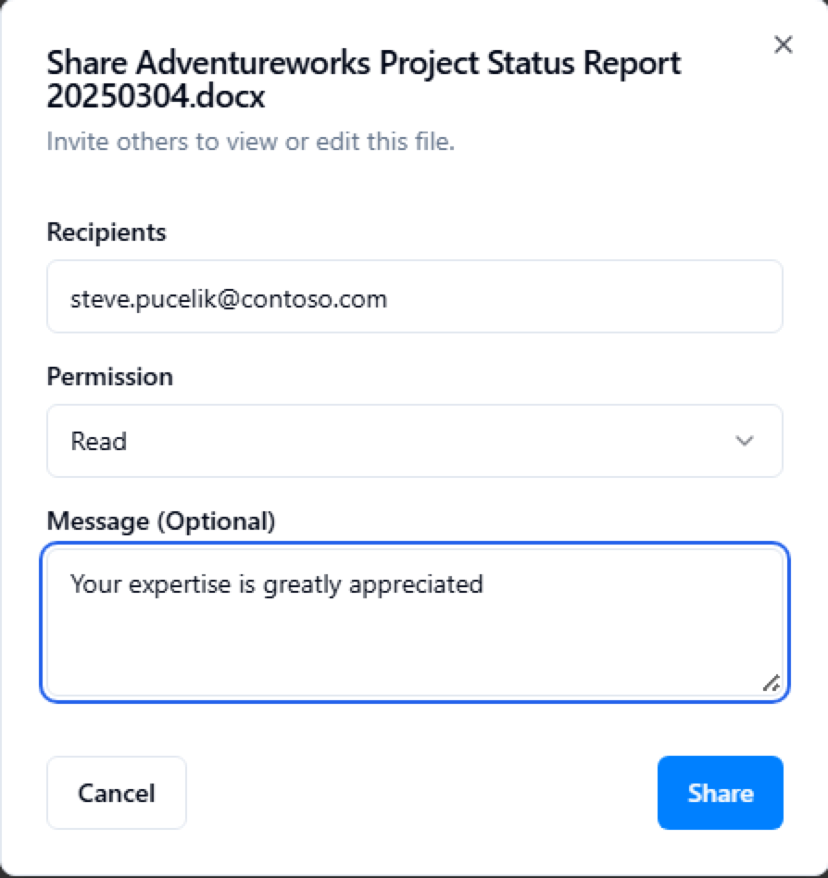

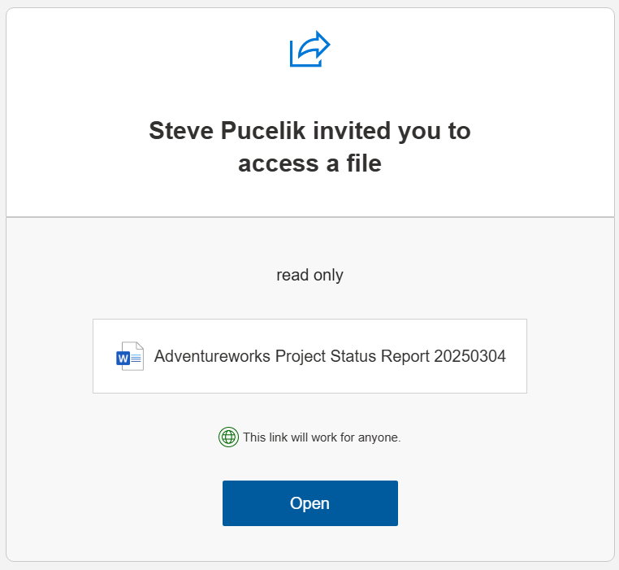
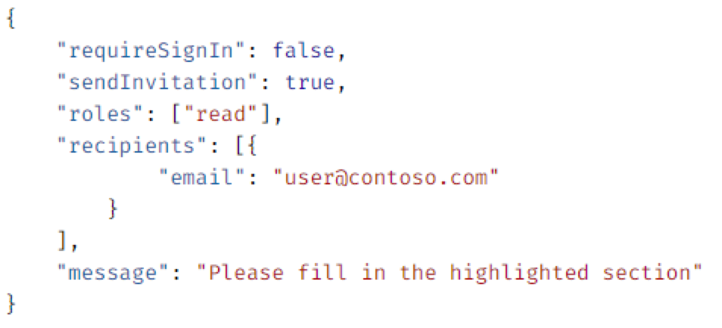


Easily Share Documents

Slide 20
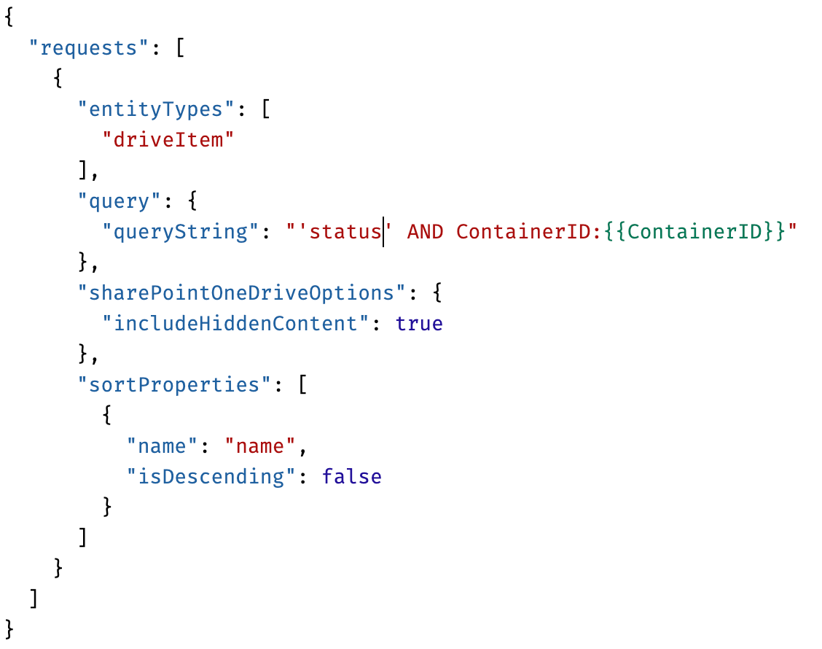
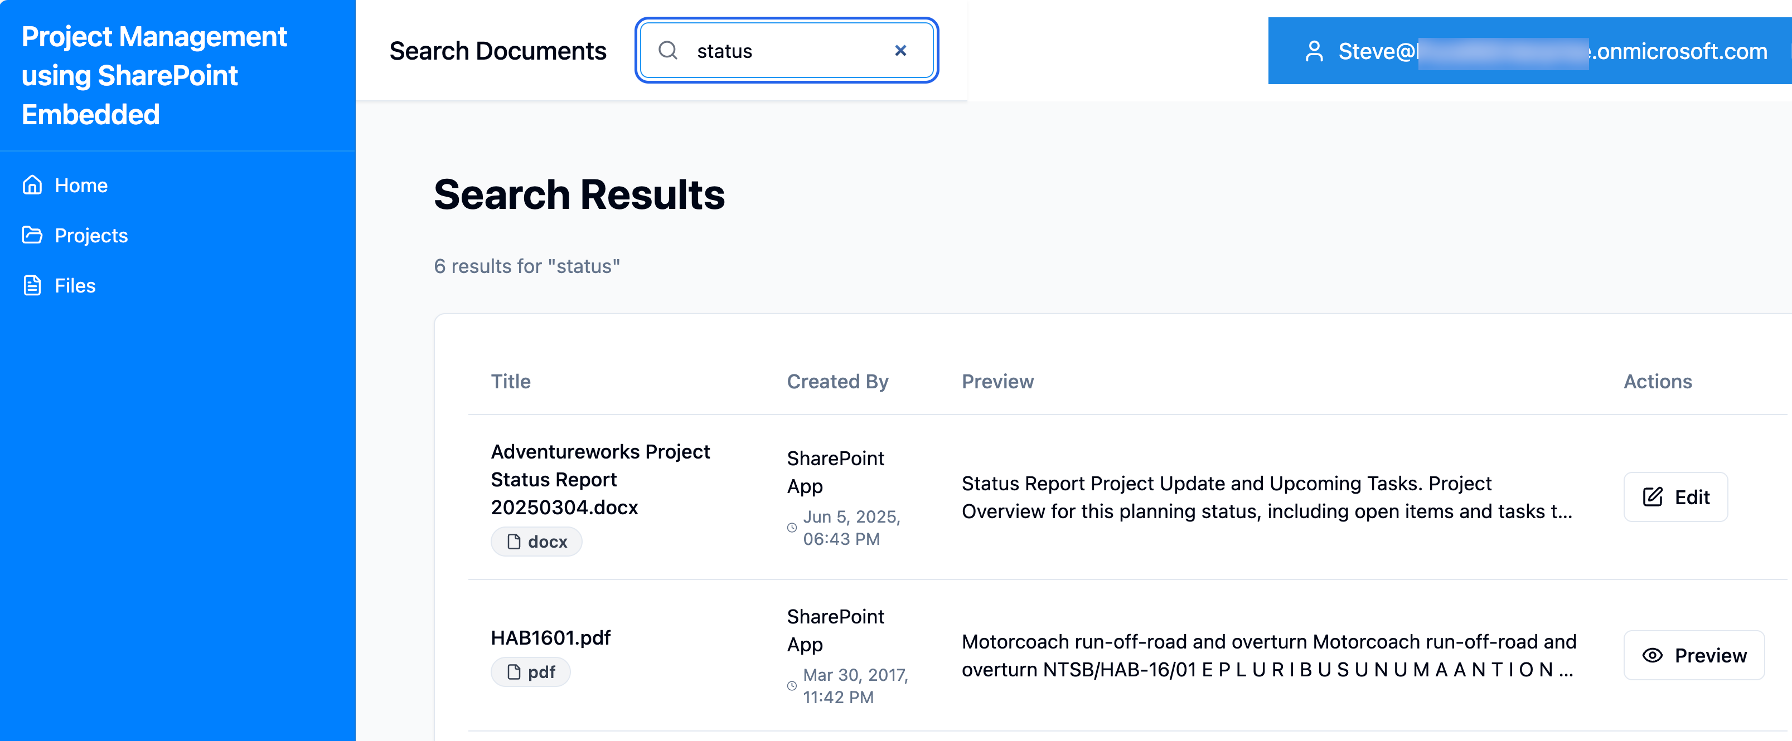
Search

Slide 21
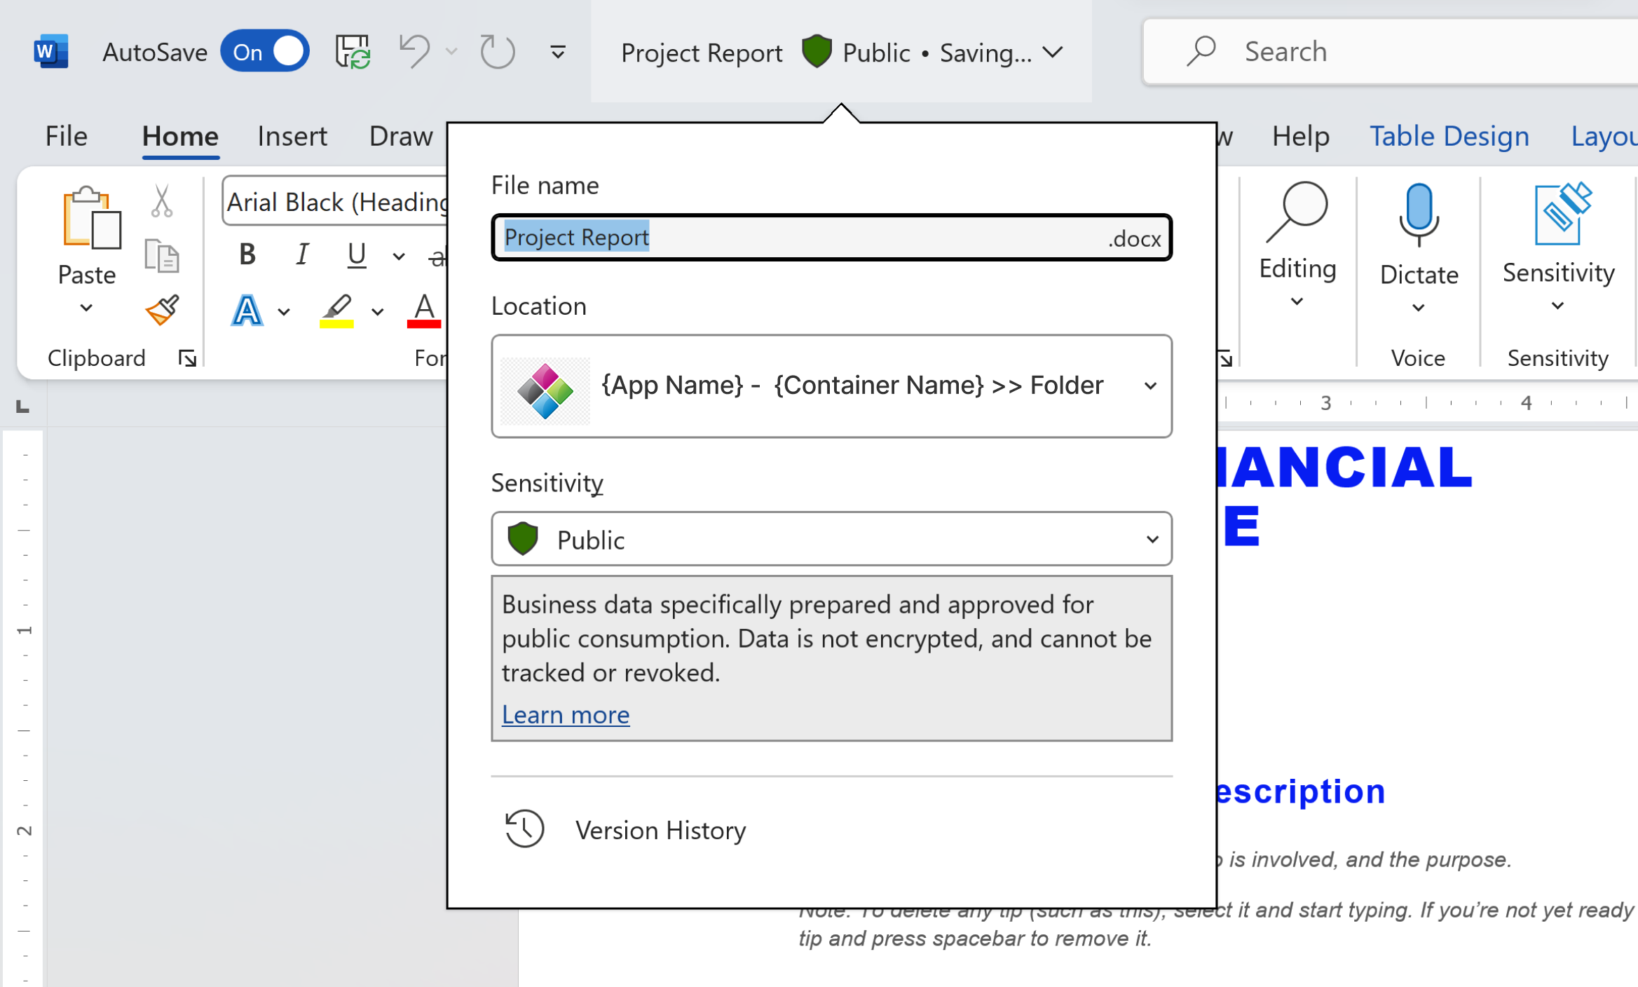
Microsoft 365 Experience Integration
Leverage native M365 user experiences in your app to accelerate development
Full Office Web & Desktop Support
Co-authoring & Collaboration
App Branding in Office
M365 Discovery – Office.com, Recommended
Embeddable File & Document Previewer
Configurable Sharing
+++

Slide 22
User Security
App Level
Container Level
File or Folder Level
Admin Level
Users must have access to the app to access containers.
Users may be an owner, manager, reader, or writer to access files and folders.
Users may be granted access to a file or folder and it’s decedents.
Users may be restricted from accessing a file or folder and it’s decendents.
Grant admins a role to view and manage containers only, without wider SharePoint admin rights

Slide 23
Application Security
App-only and App + User (Delegated) both supported
Choice is dependant on the use case of your app
Set through the app registration in Entra ID
Uses FileStorageContainer.Selected scope in Graph
Additional Container Type configuration grants access to specific container types for an app

Slide 24
Container Permissions
Each container has 4 built in roles
Owner, Manager, Writer, Reader
Entra users or groups are added to these roles to grant permissions
Granular permissions can also be set for files and folders
Create custom SPGroups for each container for a locally scoped group object
Sensitivity labels can also be used to add another layer of control

Slide 25
Sharing Permissions
Inherits from the SharePoint Admin settings
PowerShell can override this for a single app
Share a document
Specify permissions (read/edit)
Create a link
Link type parameters (Send notification)
Scope (User/Group)

Slide 26
App containers are strongly typed
App 1
App 2
App 3
Graph APIs
Container Type 1
Container Type 2
Container Type 3
SharePoint Embedded
Containers
RaaS 1
RaaS 1
RaaS 1
RaaS 1
RaaS 1
RaaS 1
Microsoft 365 Tenant Boundary

Slide 27
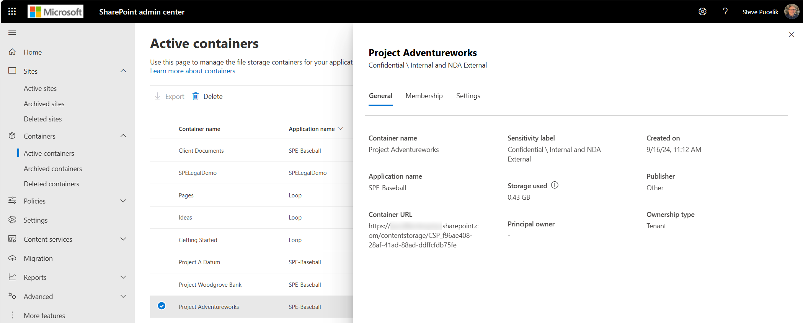
SharePoint Admin Center Integration
Container Management
View all containers for your application
Manage container permissions
Apply sensitivity labels
Restore deleted containers

Slide 28
Balanced Approach
Things You Develop
Features You Use
App Registration
Microsoft Graph APIs
M365 Copilot, App Copilot
Word, Excel, PowerPoint, OneUp
Robust security
SharePoint Admin Center
eDiscovery
Global Audit
Purview Features
User Experience
Container architecture
File handling logic
LOB integration

Slide 29
Core SharePoint Embedded Use Cases
Claims Processing
Health Records
Statements
Pharma Research
Origination
Clinical Studies
Customer Onboarding
Plant Safety
Mortgage Documents
Insurance
Healthcare
Design Documents
Investor Services
Consumer Products
FSI
Manufacturing
Audit
FOI Process
Tax
General Services
Legal
Government
Grant Processing
Professional Services

Slide 30
SharePoint Embedded Meters
Service Meters | Meter Unit | Price
Storage | $/GB/Day | $0.00667
Graph API Transactions | $/1 API call | $0.00050
Express Egress | $/GB | $0.05
https://aka.ms/spe-adoption

Slide 31
SPE: Optimized for Document Management in Apps
 | SharePoint Online | SharePoint Embedded
Hyper Scale Document Manager | Yes | Yes
Native Word, Excel, PowerPoint, ++ | Yes | Yes
Lightweight Document Containers | No | Yes
Rich Security Controls | Yes | Yes
Built In User Experience | Yes | No
Manages Websites | Yes | No
Stores Data in Lists | Yes | No
Business Model | M365 Entitlement + Extras | Azure Meters
API Resource Usage Model | M365 Entitlement | 2x Largest Entitlement*
Audit, eDiscovery, Purview | Yes | Yes
SPAC Integration | Yes | Yes
API Models | Graph, CSOM (REST) | Graph

Slide 32
Resource Allocation Comparison
SharePoint Online
SharePoint Embedded
Based on total licensed users
1k users = 1,200 resource units / min
1k-5k = 2,400
5k-15k = 3,600
15k-50k = 4,800
50k+ = 6,000
Avoid getting throttled or blocked in SharePoint Online | Microsoft Learn
Not based on users
Per app per tenant = 12,000 resource units / min
(can be increased)
SharePoint Embedded Limits and Calling Patterns | Microsoft Learn

Slide 33
SPE compared to CSPP / CSPP+
 | SPE | CSPP | CSPP+
Entra Identity Aware | Yes | No (Based on 3P) | No (Based on 3P)
Entra Guest Users | Yes | No (Based on 3P) | No (Based on 3P)
Comprehensive M365 integration (Beyond WXP) | Yes | No | No
Stores documents inside M365 boundary | Yes | No | No
Geo specific data processing | Yes | No | No
Asynchronous Collaboration (Mentions, task, notifications) | Yes | No | No
Coauthoring | Yes | Yes (Limited) | Yes (Based on 3P)
Purview (Audit, E-discovery, Sensitivity Labels, etc) | Yes | No | No
E3, E5 (BYOK, DLP, etc) | Yes | No | No
FedRAMP (GCC Mod, High) | Yes | No | Yes
Copilot / Agent Experiences | Yes | No | No
WXP Web / Desktop | Yes | Web / Mobile | Web / Desktop / Mobile

Slide 34
File Management Options for Your Apps
SPE
SPO
CSPP / CSPP+
High Resource Limits
DIY User Experience
License Based Resource Limits
SPO User Experience
Document Editing Only
Does not guarantee processing geo

Slide 35
Resources
Microsoft Learn: https://aka.ms/start-spe
YouTube Playlist: https://aka.ms/spe-playlist
Code Samples: https://aka.ms/spe-samples
Educate Your Stakeholders: https://aka.ms/spe-2min
Vibe Code + MCP: https://aka.ms/spe-vibe
YES! You can have this deck.

Slide 36
Building AI Apps
A New Way to Build a New Kind of App
SharePointEmbedded＠Microsoft.com

Slide 37
Integrated AI Platform for Document Apps
Security
AI Native
SharePoint Embedded
Full AI stack for enterprise apps and agents
Commitments
Capabilities
Collab

Slide 38
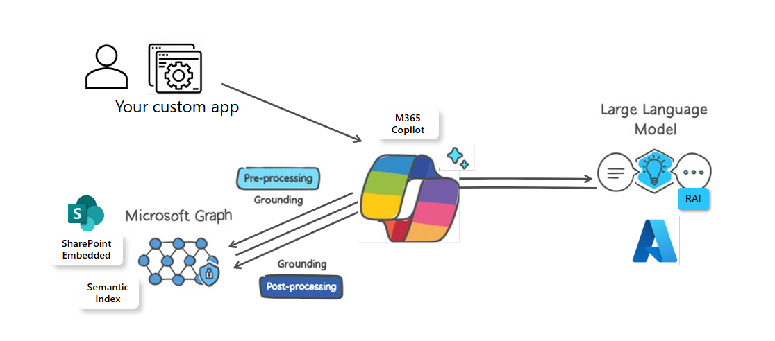
What happens to a document

Slide 39
AI Ingredients – Copilot Delivers All Four
LLM Connection
Semantic Index/Retrieval API
LLM Orchestrator
User Experience

Slide 40
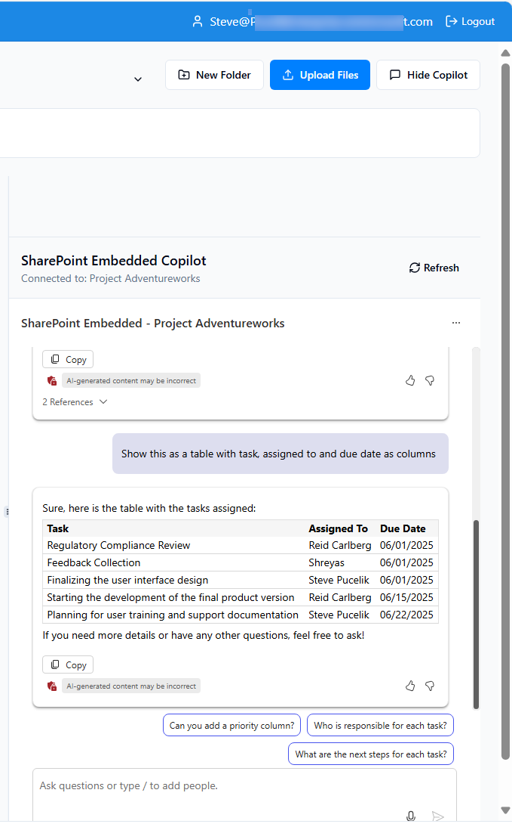
The SharePoint Embedded Agent
Ready-made UI control you add to your web app
Microsoft 365 Copilot platform
Rich document understanding
Copilot orchestrated
Integrated security and compliance
Grounded on your app’s documents
Customize data sources, prompts, and UI
Consumption billed

Slide 41





Successfully developing AI Agents requires
4 primary considerations
Knowledge
Providing agents with the right context
Actions
Giving them the tools to complete their tasks
Security
Ensuring they only have access to what they should
Evaluation
Ensuring they complete their tasks correctly

Slide 42
Demo #2

Slide 43
Demo Agenda
Project App
Pick this up with custom SPE Agent
M365 Biz Chat copilot
Show Copilot in Project App documents
Surface a DA from app in Teams

Slide 44
Business Model
Copilot Licenses
Copilot Meters
Microsoft 365 Copilot
WXP Copilot
SPE Agent
Semantic Index Query

Slide 45
Getting Started
A New Way to Build a New Kind of App
SharePointEmbedded＠Microsoft.com

Slide 46
Build Your First SharePoint Embedded App
Prerequisites
Microsoft 365 tenant (Developer / Commercial)
Copilot license (for copilot feature)

Slide 47
Demo Agenda
Open VS Code
Install SharePoint Embedded Plugin
Connect to M365 tenant
Create your container type
Create a single container
Show it in your M365 tenant SPAC
Copy the properties from
Git clone demo app
Open standard demo app in VS Code Insiders
Use Agent to Update properties
Show it working
Vibe Coding Prompts in Samples

Slide 48
Compliance & Admin
A New Way to Build a New Kind of App
SharePointEmbedded＠Microsoft.com

Slide 49
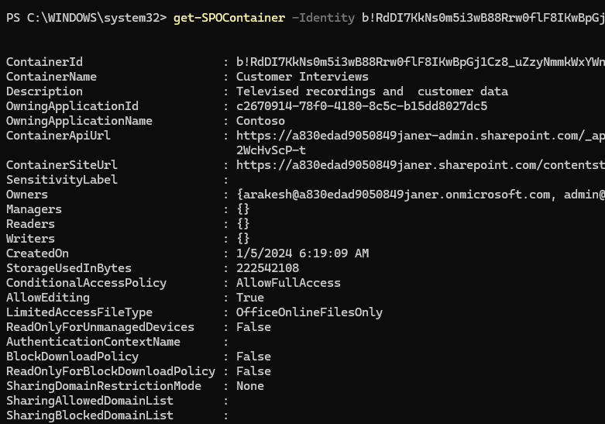
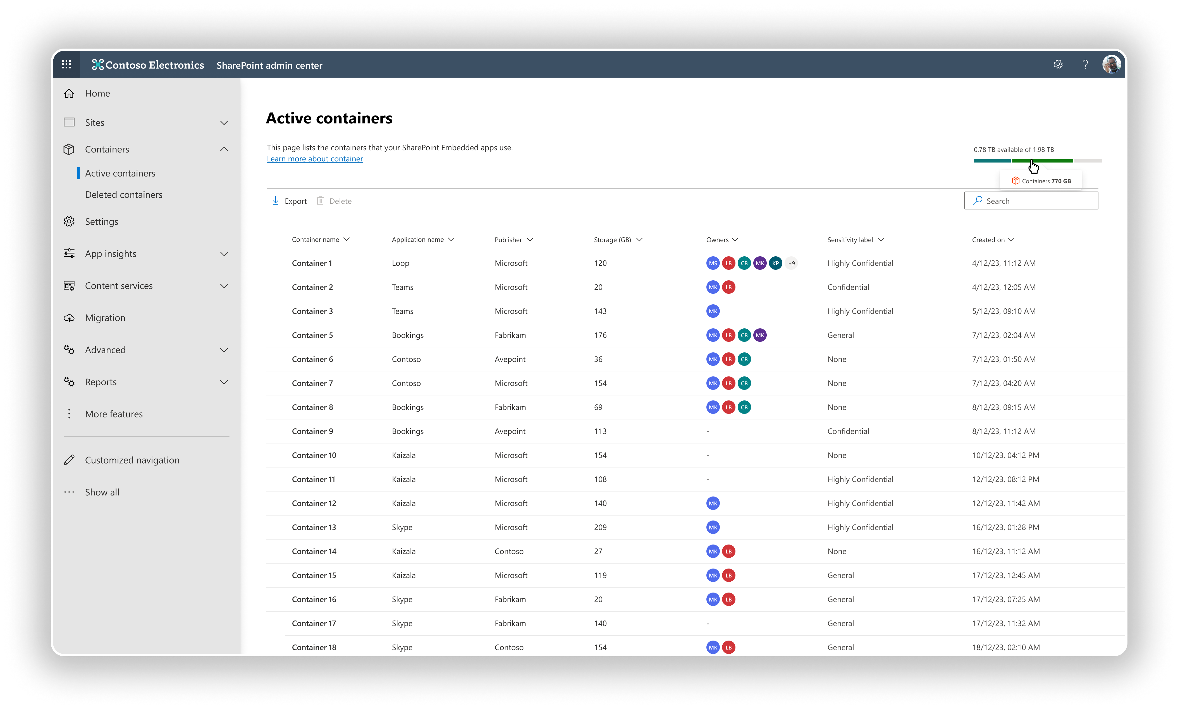
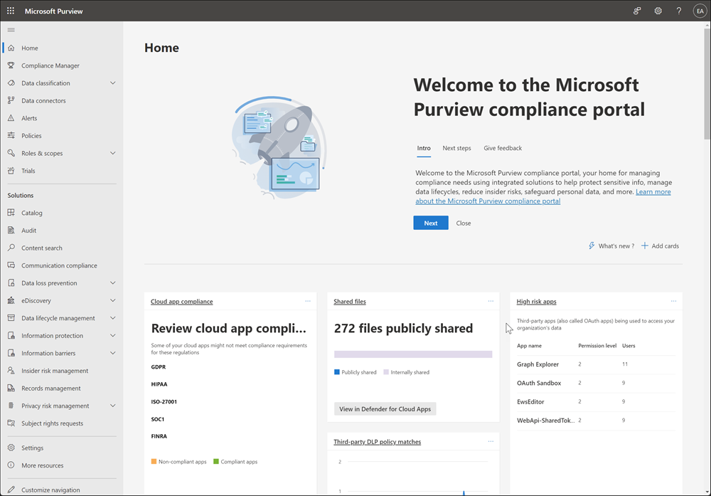

Admin Tools
PowerShell
SharePoint Admin Center
Purview
Graph API
Expand on existing solutions
Familiar Admin Center in M365 Admin
Build admin solutions using the APIs
FileStorageContainer.Manage.All

Slide 50
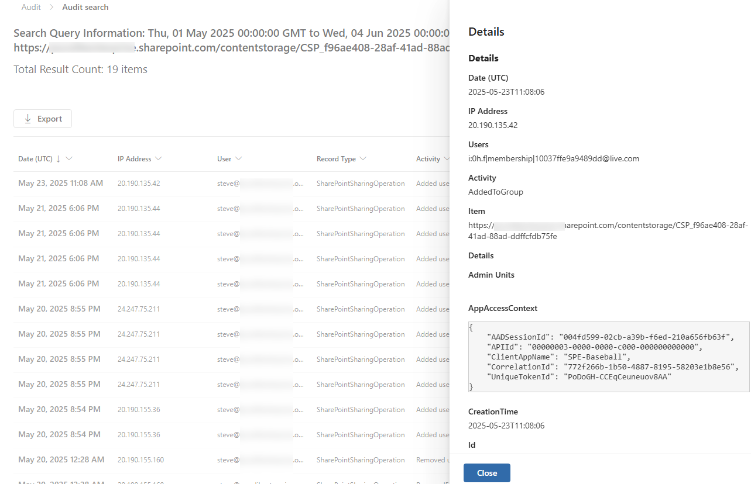
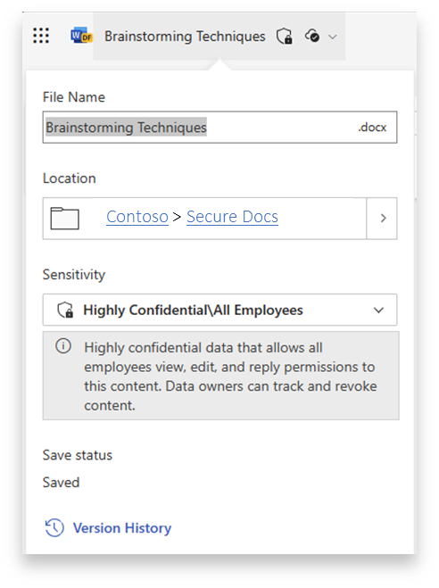
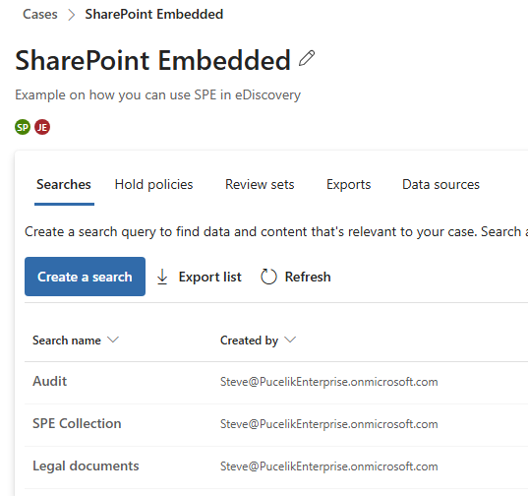
Microsoft Purview Integration
Microsoft 365 security & compliance policies automatically apply to SharePoint Embedded content
Audit
Sensitivity Labels
eDiscovery
Also supports DLP, BYOK, retention policy, multi-geo, conditional access and more.

Slide 51
Demo #3

Slide 52
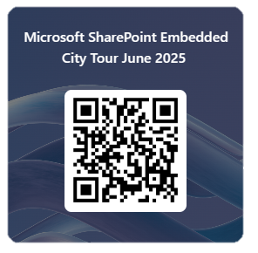
Thank you!
Please help us improve by providing your feedback.
Questions? sharepointembedded@microsoft.com
https://aka.ms/spe-event-survey

